Slide 1






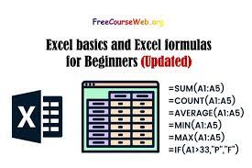

EXCEL
ICT DIVISION BANGLADESH
MY ACCESSORISE
Welcome to my Presentation
WORD DOC
OFFICE
EXCEL FORMULA
POWER POINT
EXCEL LOGIC

Slide 2

About Me
Name: Sajib Ahmed
Department: English
Serial No.:
Topic: Critical Examination of Excel.

Slide 3
PRESENTATION ROADMAP
Excel
Chart
Dash
Word
Introductory Analysis
Formula Analysis
Introductory Analysis
Implement Analysis
Structural Framework
Structural Framework

Slide 4
Excel Key Activities:
Applying IF Formula
Printing Gradesheet with Letter Grade
Inserting Dynamic Pie Chart
Creating Dashboard
Implanting Mannual Conditional Formating
Applying IF, IFS, COUNT,COUNTIFS,VLOOKUP

Slide 5
Word Key Activities:
Editing Header Section
Applying Page Number
Creating Table of Content
Using Header Function Maintaining Catgory
Highlighting Topic Names
Adding Watermark
Editing Line Spacing
Altering the Background
Adding Footer
Including Footnote

Slide 6
Thanks to Md. Erfan Sir
THANK YOU
Curtesy of
ICT Division | EDGE | BU
Sajib Ahmed | 4 June 2024 | sahmed19.eng@bu.ac.bd

